Slide 1
Real Time Signboard Detection and Recognition using Salient Object Detection
Project Guide
Professor Dr. Saugata Sinha
Presented by
Chaitanya Belhekar
Tejas Bujade
Dhananjay Krishna
Tejash Popate

Slide 2
What is saliency?
Saliency is an important property of human visual perception.
It is the ability or quality of a region in an image to standout (or be prominent) from the rest of the scene and grab our attention.
The objects which appear different from the background are noticed by human eye are the focus of interest.
Vision is the process of discovering from images what is present in the world, and where it is.

Slide 3
What our project is about?
Salient Object Detection .
Detect the sign-boards in the image using salient object detection algorithm.
Segmentation and snipping of the sign-boards from the rest of the image.
Extracting details from the signboard.
Sign-board’s text is mapped to the respective location in the GPS map.

Slide 4
How it is different?
Detection is extended to any kind of object such as billboards, traffic signs, monumental boards.
Previous methods concentrated on similar structure and pattern of objects.
The location of boards are automatically pinned on maps.
The data extracted from the boards are uploaded at pinned location.

Slide 5
How it works?
Capturing the frames with object of interest
Computing Saliency Map using GBVS
Obtaining the required Region of Interest
Detecting the boundaries
Linking the image to its GPS location
Extracting the details from cropped board
Cropping of board from acquired boundaries

Slide 6
How the algorithm works?
Calculate saliency map using GBVS method.
Extract region of interest (ROI) within saliency map using morphological operations.
Removing the noise in the saliency map by considering regions having high saliency values using threshold.
Apply saliency map as mask to obtain ROI from the original image.
Label the connected regions from saliency map and crop region of the image having largest area v.i.z. the required region for the signboard.
Use optical character recognition (OCR) method to extract alphanumeric data from the cropped region. Data obtained is saved for further purposes.

Slide 7
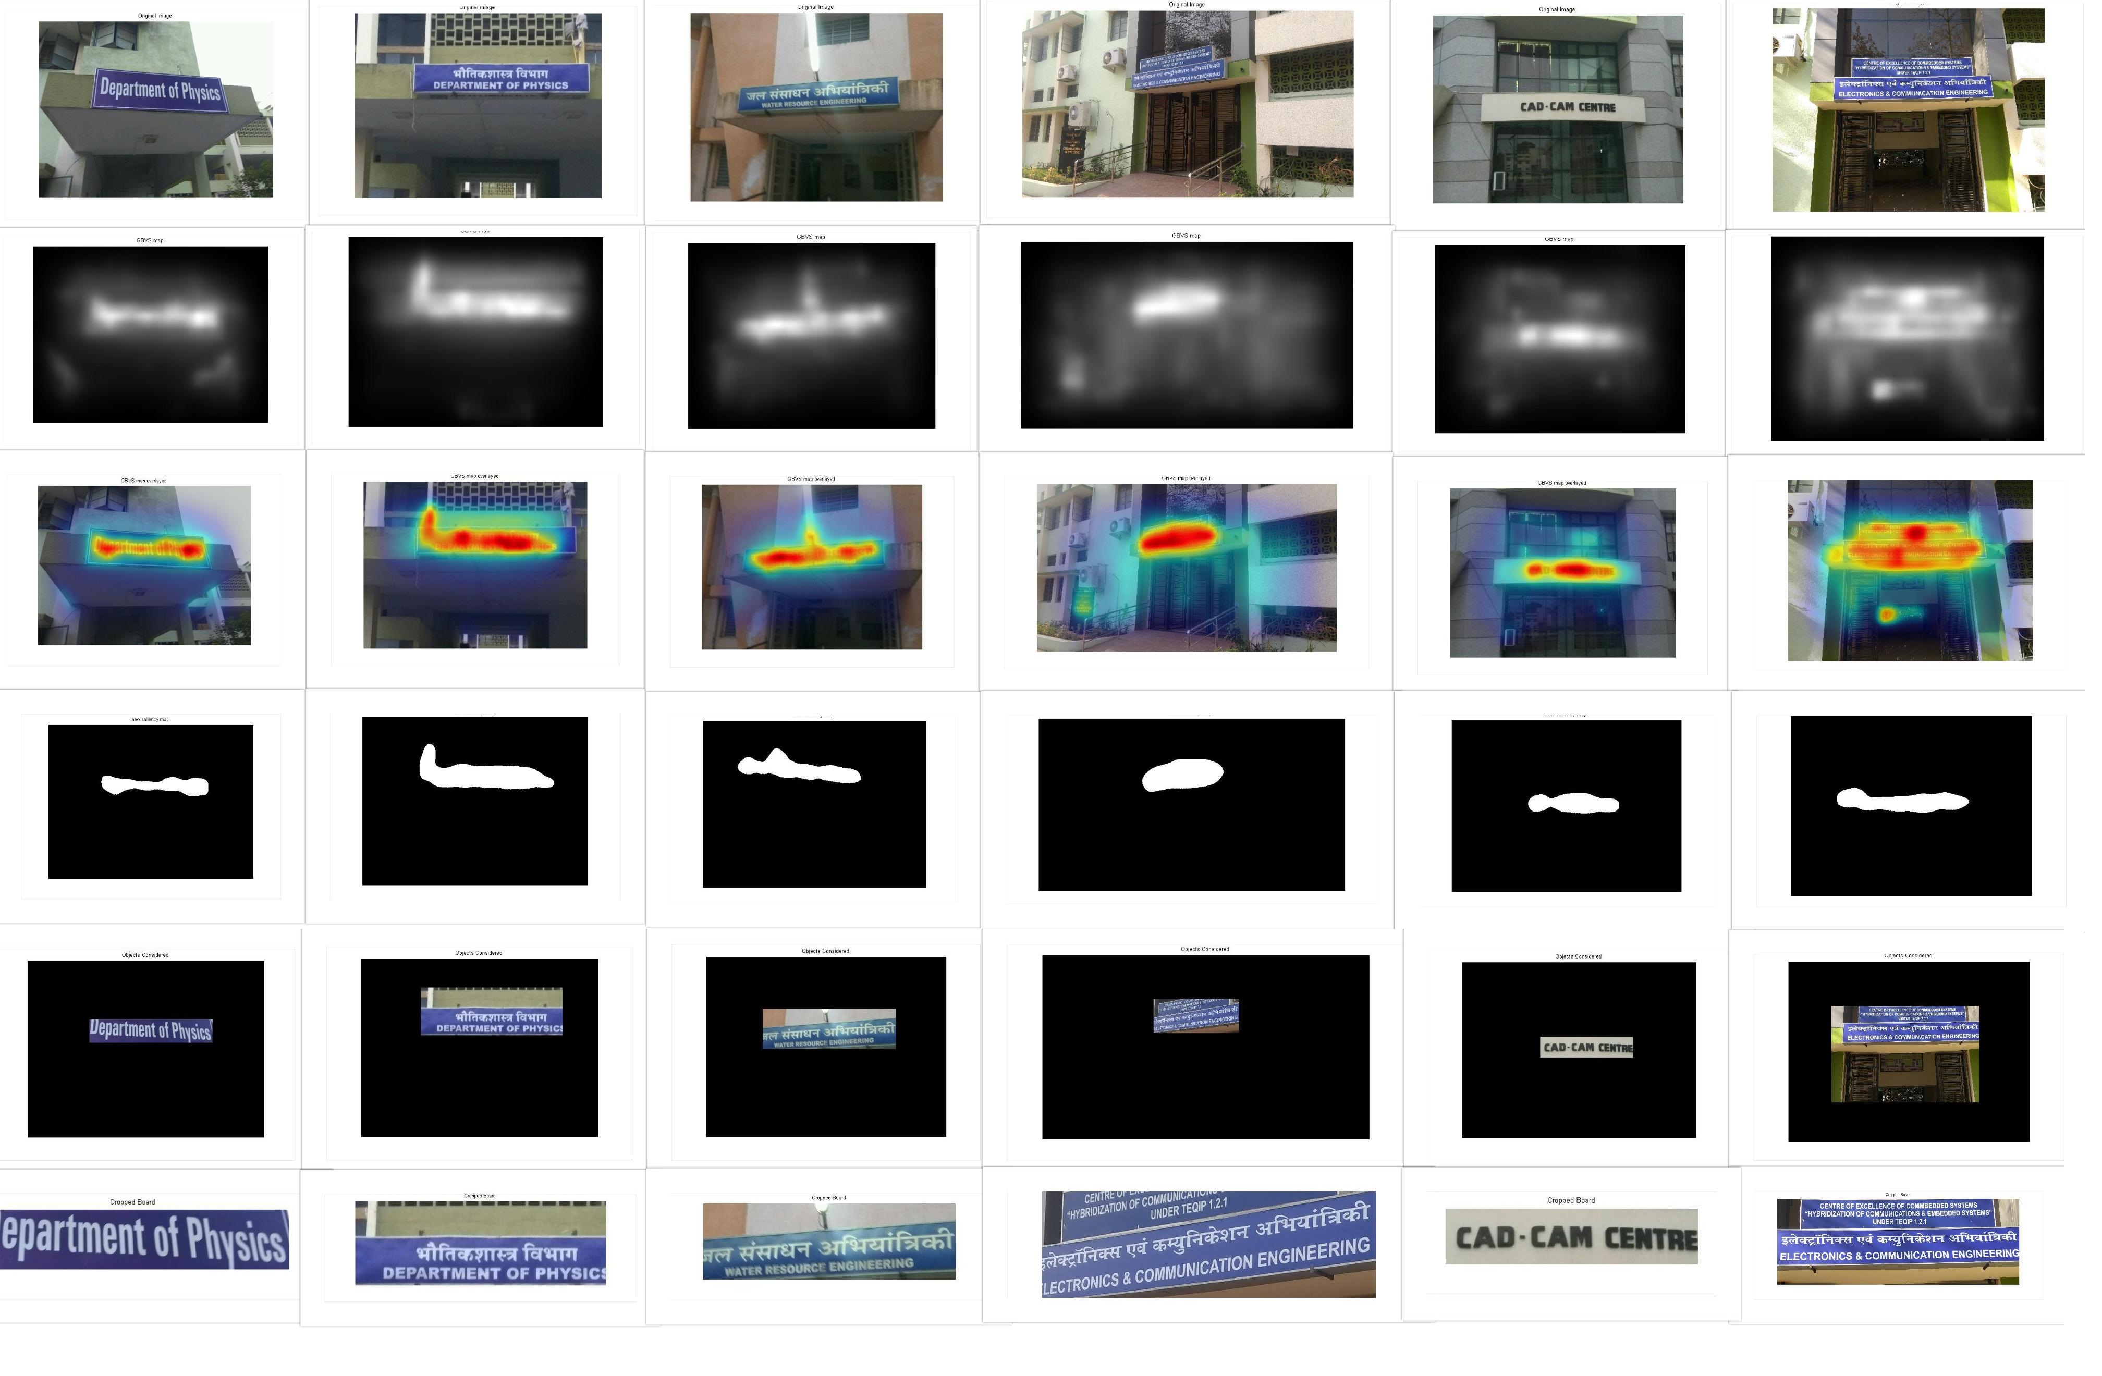
What are the results obtained?

Slide 8
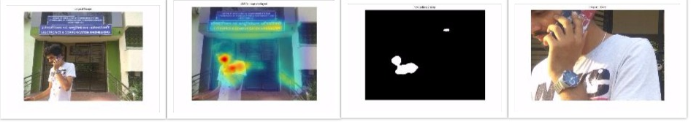
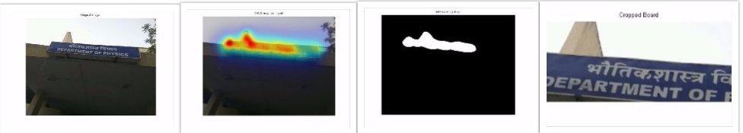
What are the constraints?
In case of multiple salient object sometimes the object detected is not the object of interest.
The orientation of the board limits its detection
OCR is not applicable where text in the image is not clear.

Slide 9

How we implemented it?

Slide 10
Demonstration

Slide 11
References
Itti, L., C. Koch, and E. Niebur (1998). A model of saliency-based visual attention for rapid scene analysis. TPAMI, 20(11), 1254–1259.
Borji A, Itti L (2013) State-of-the-art in visual attention modeling. IEEE Transactions on Pattern Analysis and Machine Intelligence 35:185–207.
Harel J, Koch C, Perona P (2007) Graph-based visual saliency. In: Advances in Neural Information Processing Systems 19. MIT Press pp. 545–552.
E. Nowak, F. Jurie, and B. Triggs, “Sampling strategies for bag of- features image classification,” in Computer Vision ECCV 2006 (A. Leonardis, H. Bischof, and A. Pinz, eds.), vol. 3954 of Lecture Notes in Computer Science, pp. 490–503, Springer Berlin Heidelberg, 2006

